Slide 1
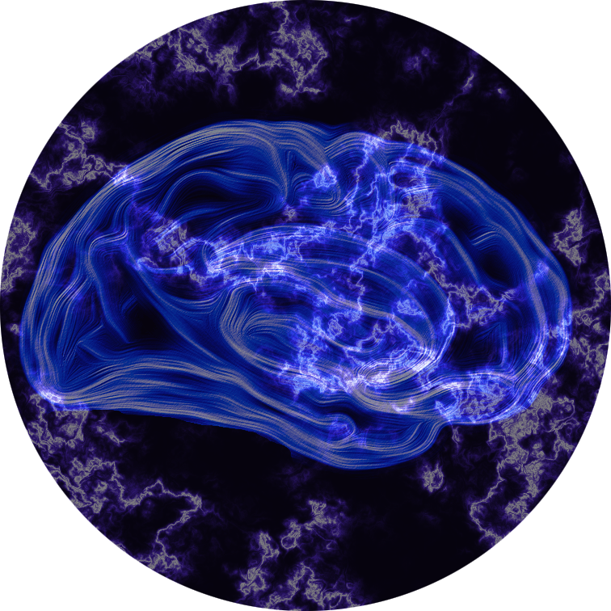
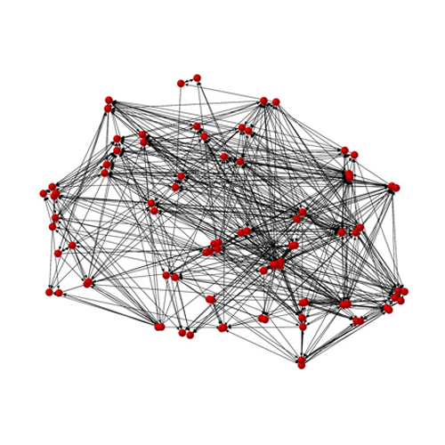
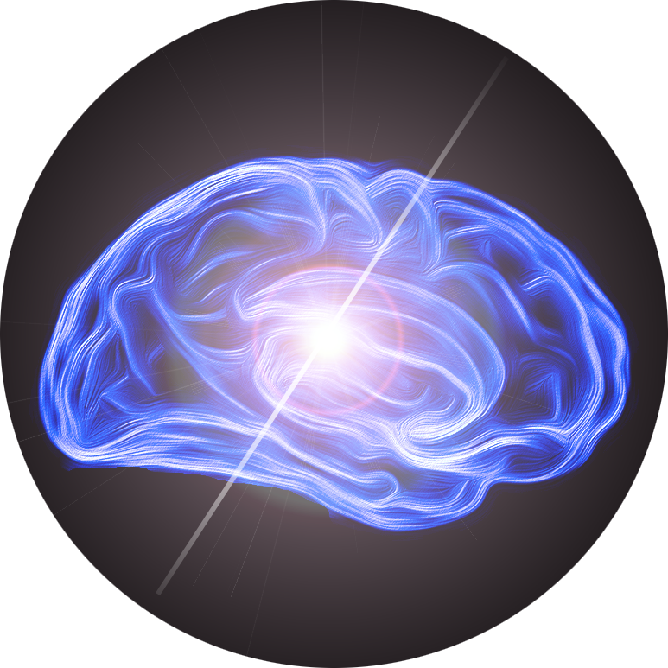
Data Processing & Analysis of Resting-State fMRI (Part II)
Chao-Gan YAN, Ph.D.
严超赣
ycg.yan@gmail.com
http://rfmri.org
Research Scientist
The Nathan Kline Institute for Psychiatric Research
Research Assistant Professor
Department of Child and Adolescent Psychiatry /
NYU Langone Medical Center Child Study Center, New York University
The R-fMRI Course V2.0

Slide 2
Disclosure
Initiator
DPARSF, DPABI, PRN and The R-fMRI Network (RFMRI.ORG)
Founder, Chief & Programmer
My Research Network (RNET.PW)

Slide 3
Outline
DPARSF (Basic Edition)
RNET: a cloud way for doing research

Slide 4
DPARSF
(Yan and Zang, 2010)

Slide 5
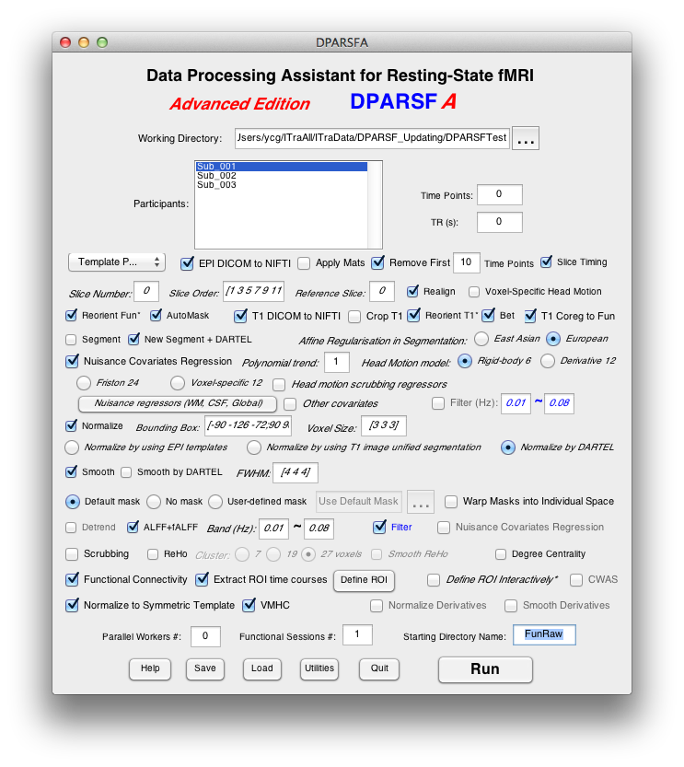
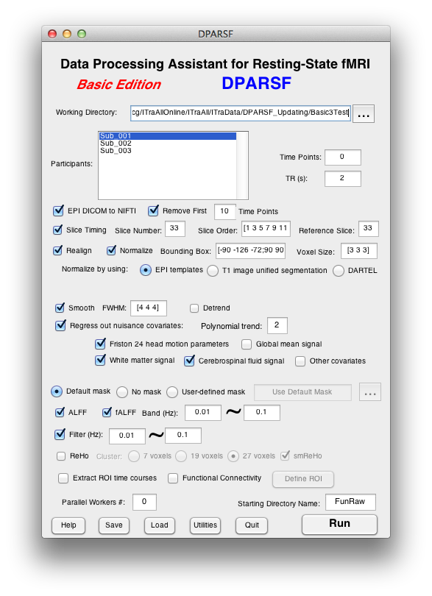
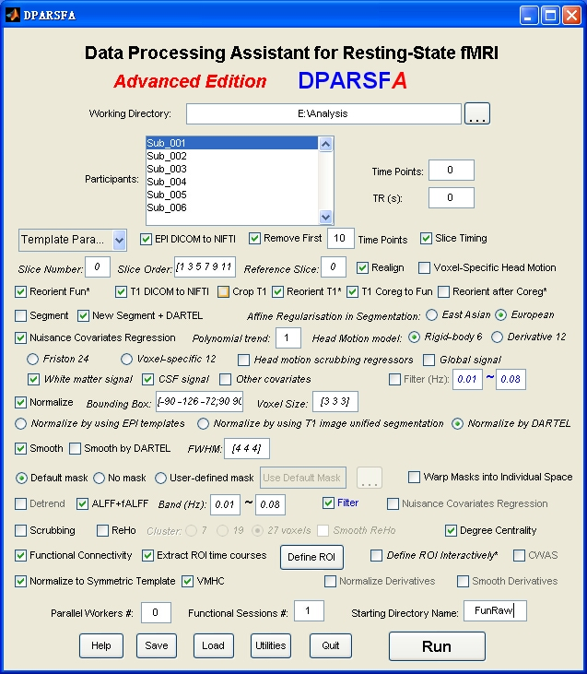
Data Processing Assistant for Resting-State fMRI (DPARSF)
Yan and Zang, 2010. Front Syst Neurosci.
http://rfmri.org/DPARSF

Slide 6
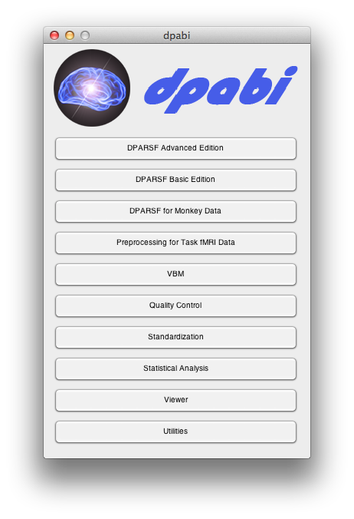
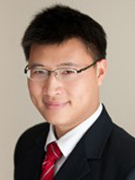
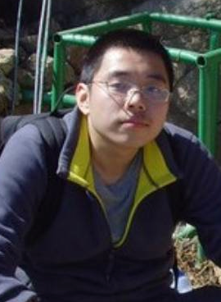
DPABI: a toolbox for Data Processing & Analysis of Brain Imaging
License: GNU GPL
Chao-Gan Yan Programmer Initiator
Xin-Di Wang Programmer
http://rfmri.org/dpabi
http://dpabi.org

Slide 7
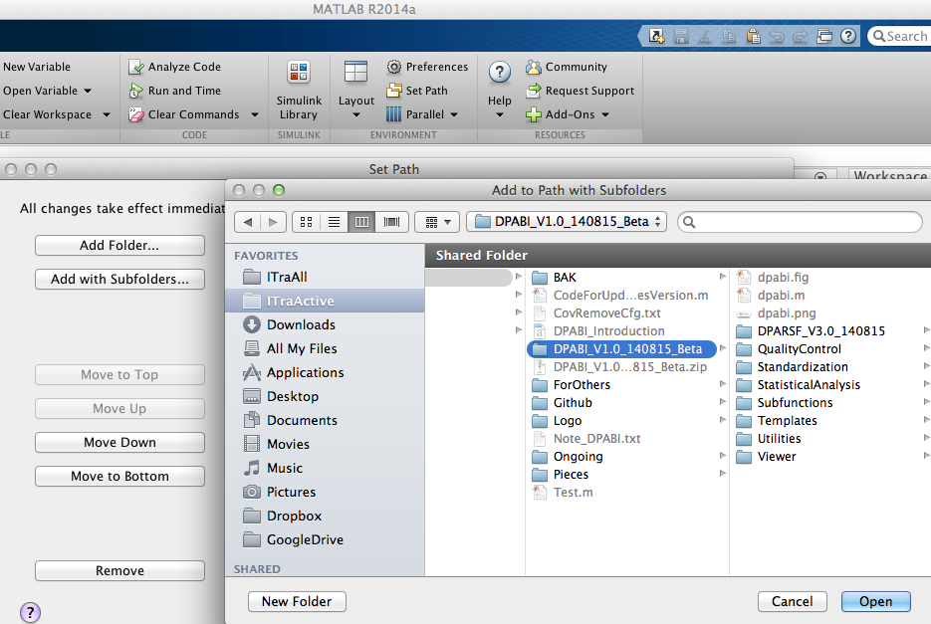
7

Slide 8
DPARSF
Data Preparation
Preprocessing
ReHo, ALFF, fALFF Calculation
Functional Connectivity
Utilities

Slide 9
Data Organization
ProcessingDemoData.zip
FunRaw
Sub_001
Sub_002
Sub_003
T1Raw
Sub_001
Sub_002
Sub_003
Functional DICOM data
Structural DICOM data
http://rfmri.org/DemoData

Slide 10
Data Organization
ProcessingDemoData.zip
FunImg
Sub_001
Sub_002
Sub_003
T1Img
Sub_001
Sub_002
Sub_003
Functional NIfTI data (.nii.gz., .nii or .img)
Structural NIfTI data (.nii.gz., .nii or .img)

Slide 11
DPARSF
Data Preparation
Preprocessing
ReHo, ALFF, fALFF Calculation
Functional Connectivity
Utilities

Slide 12
DPARSF Basic Edition's procedure
Convert DICOM files to NIFTI images
Remove First 10 Time Points
Slice Timing
Realign
Normalize
Smooth (optional)
Detrend (optional)
Nuisance covariates regression
Calculate ALFF and fALFF
Filter
Calculate ReHo (without smooth in preprocessing)
Calculate Functional Connectivity

Slide 13
DPARSF Basic Edition's procedure
Convert DICOM files to NIFTI images
Remove First 10 Time Points
Slice Timing
Realign
Normalize
Smooth (optional)
Detrend (optional)
Nuisance covariates regression
Calculate ALFF and fALFF
Filter
Calculate ReHo (without smooth in preprocessing)
Calculate Functional Connectivity

Slide 14
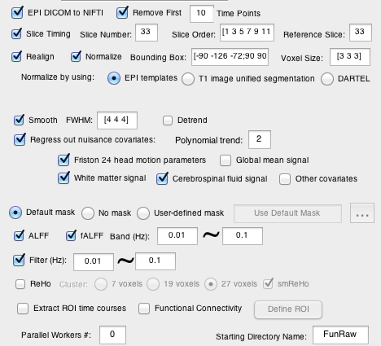
DPARSF

Slide 15
DPARSF Basic Edition's procedure
Convert DICOM files to NIFTI images
Remove First 10 Time Points
Slice Timing
Realign
Normalize
Smooth (optional)
Detrend (optional)
Nuisance covariates regression
Calculate ALFF and fALFF
Filter
Calculate ReHo (without smooth in preprocessing)
Calculate Functional Connectivity

Slide 16
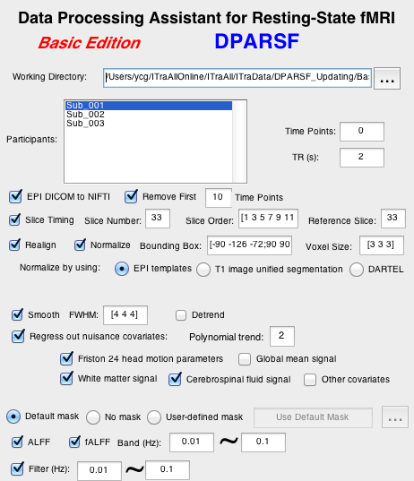
DPARSF

Slide 17
DPARSF Basic Edition's procedure
Convert DICOM files to NIFTI images
Remove First 10 Time Points
Slice Timing
Realign
Normalize
Smooth (optional)
Detrend (optional)
Nuisance covariates regression
Calculate ALFF and fALFF
Filter
Calculate ReHo (without smooth in preprocessing)
Calculate Functional Connectivity

Slide 18
Slice Timing
Why?

Slide 19
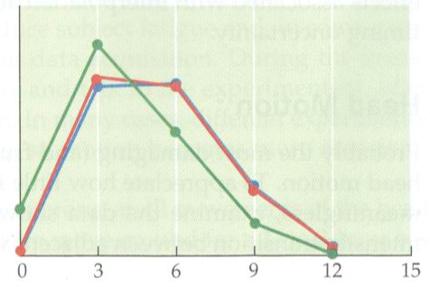
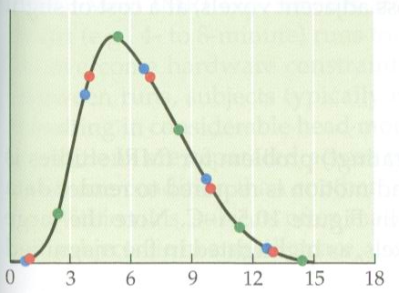
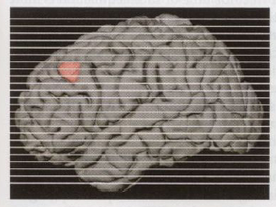
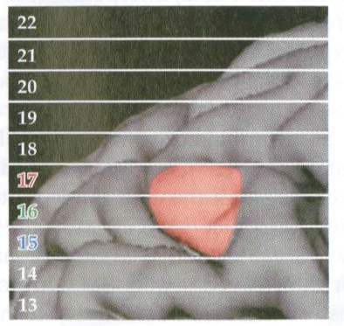
Slice Timing
Why?
Huettel et al., 2004

Slide 20
DPARSF
1:2:33,2:2:32

Slide 21
DPARSF Basic Edition's procedure
Convert DICOM files to NIFTI images
Remove First 10 Time Points
Slice Timing
Realign
Normalize
Smooth (optional)
Detrend (optional)
Nuisance covariates regression
Calculate ALFF and fALFF
Filter
Calculate ReHo (without smooth in preprocessing)
Calculate Functional Connectivity

Slide 22
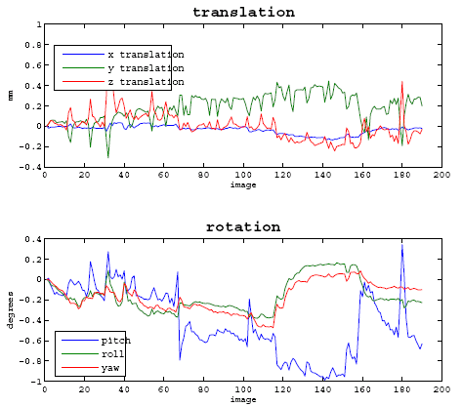
Realign
Why?

Slide 23
DPARSF

Slide 24
Realign
Check head motion:
{WorkingDir}\RealignParameter\Sub_xxx:
rp_*.txt: realign parameters
FD_Power_*.txt: Frame-wise Displacement (Power et al., 2012)
FD_VanDijk_*.txt: Relative Displacement (Van Dijk et al., 2012)
FD_Jenkinson_*.txt: Relative RMS (Jenkinson et al., 2002)

Slide 25
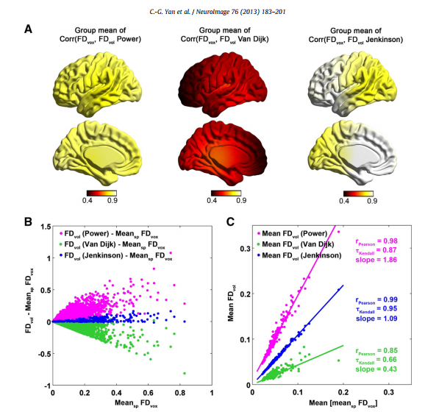
Realign
(Yan et al.,
Neuroimage
2013a)
25

Slide 26
Realign
Excluding Criteria: 2.5mm and 2.5 degree in max head motion
None
Excluding Criteria: 2.0mm and 2.0 degree in max head motion
Sub_013
Excluding Criteria: 1.5mm and 1.5 degree in max head motion
Sub_013
Excluding Criteria: 1.0mm and 1.0 degree in max head motion
Sub_007
Sub_012
Sub_013
Sub_017
Sub_018
Check head motion:
{WorkingDir}\RealignParameter:
ExcludeSubjectsAccordingToMaxHeadMotion.txt
26

Slide 27
Realign
Check head motion:
HeadMotion.csv: head motion characteristics for each subject (e.g., max or mean motion, mean FD, # or % of FD>0.2)
Threshold:
Group mean (mean FD) + 2 * Group SD (mean FD)
Yan et al., 2013b, Neuroimage; Di Martino, 2013, Mol Psychiatry
27

Slide 28
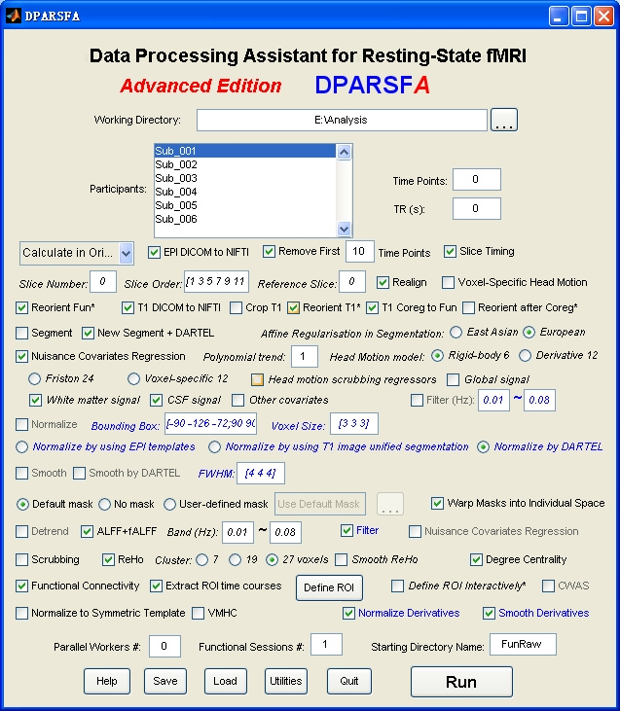
Preprocessing and R-fMRI measures Calculation
Voxel-Specific Head Motion Calculation
(Yan et al.,
Neuroimage
2013a)
28

Slide 29
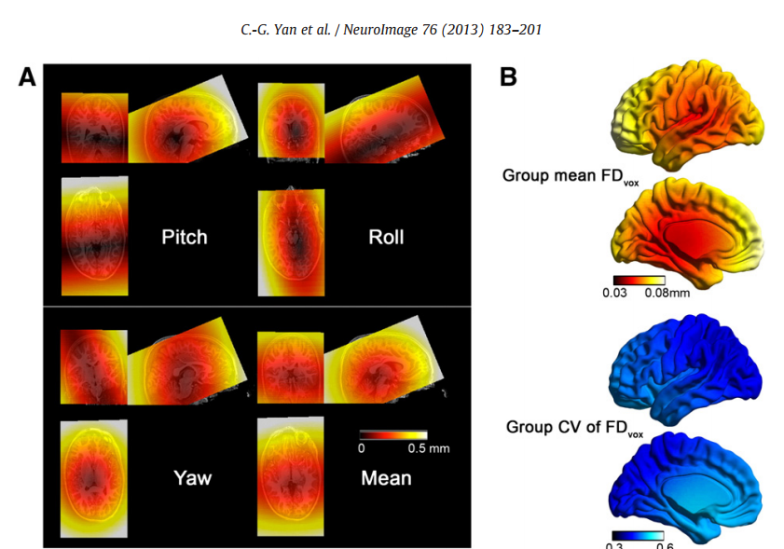
Voxel-Specific Head Motion Calculation
{WorkingDir}\VoxelSpecificHeadMotion\Sub_xxx:
HMvox_x_*.nii: voxel specific translation in x axis
FDvox_*.nii: Frame-wise Displacement (relative to the previous time point) for each voxel
TDvox_*.nii: Total Displacement (relative to the reference time point) for each voxel
MeanFDvox.nii: temporal mean of FDvox for each voxel
MeanTDvox.nii: temporal mean of TDvox for each voxel

Slide 30
DPARSF Basic Edition's procedure
Convert DICOM files to NIFTI images
Remove First 10 Time Points
Slice Timing
Realign
Normalize
Smooth (optional)
Detrend (optional)
Nuisance covariates regression
Calculate ALFF and fALFF
Filter
Calculate ReHo (without smooth in preprocessing)
Calculate Functional Connectivity

Slide 31
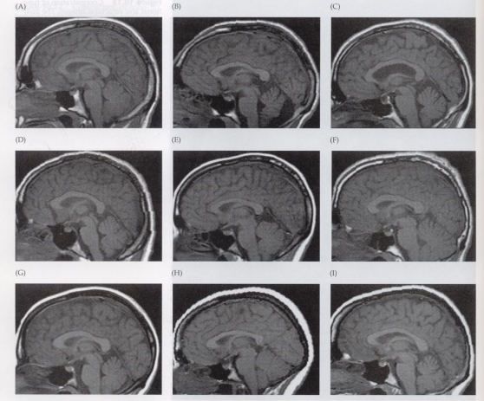
Normalize
Why?
Huettel et al.,
2004

Slide 32
Normalize
Methods:
I. Normalize by using EPI templates
II. Normalize by using T1 image unified segmentation
III. Normalize by using DARTEL
IV. Normalize by using T1 templates (Not supported)

Slide 33
Normalize
Methods:
I. Normalize by using EPI templates
II. Normalize by using T1 image unified segmentation
III. Normalize by using DARTEL
IV. Normalize by using T1 templates (Not supported)

Slide 34
DPARSF

Slide 35
Normalize
Methods:
I. Normalize by using EPI templates
II. Normalize by using T1 image unified segmentation
III. Normalize by using DARTEL
IV. Normalize by using T1 templates (Not supported)

Slide 36
Normalize
Normalize by using T1 image unified segmentation
Structural image was coregistered to the mean functional image after motion correction
The transformed structural image was then segmented into gray matter, white matter, cerebrospinal fluid by using a unified segmentation algorithm
Normalize: the motion corrected functional volumes were spatially normalized to the MNI space using the normalization parameters estimated during unified segmentation (*_seg_sn.mat)

Slide 37
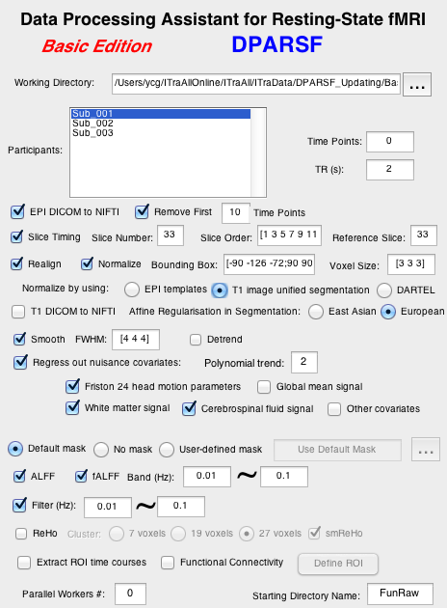
DPARSF

Slide 38
Normalize
Methods:
I. Normalize by using EPI templates
II. Normalize by using T1 image unified segmentation
III. Normalize by using DARTEL
IV. Normalize by using T1 templates (Not supported)

Slide 39
Normalize
III. Normalize by using DARTEL
Structural image was coregistered to the mean functional image after motion correction
The transformed structural image was then segmented into gray matter, white matter, cerebrospinal fluid by using a unified segmentation algorithm (New Segment)
DARTEL: create template
DARTEL: Normalize to MNI space. The motion corrected functional volumes were spatially normalized to the MNI space using the normalization parameters estimated in DARTEL.

Slide 40
DPARSF

Slide 41
DPARSF
T1 Data should be arranged in T1Raw or T1Img (co*.img) directory!

Slide 42
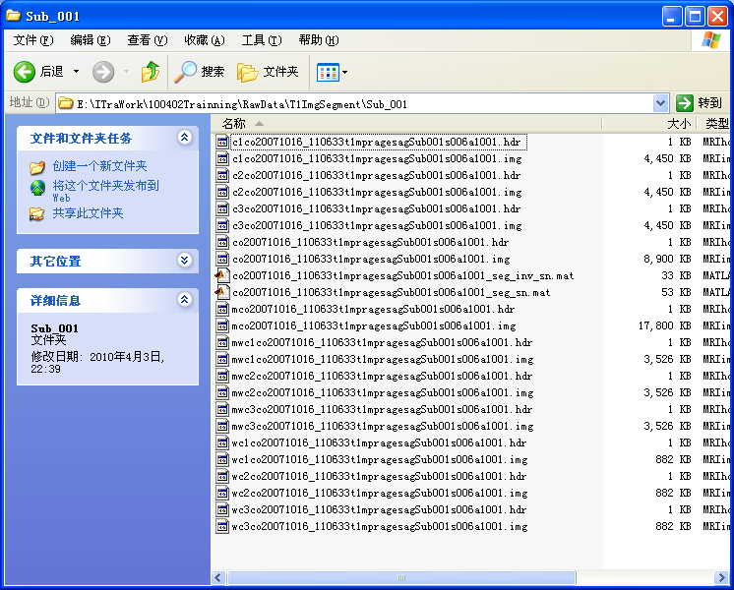
By-Product: VBM
GM in original space
WM in original space
CSF in original space
Modulated GM in normalized space
GM in normalized space

Slide 43
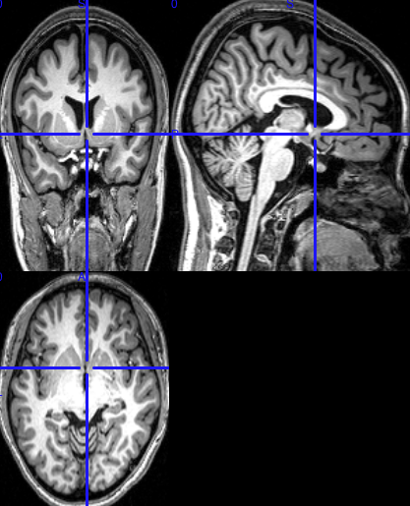
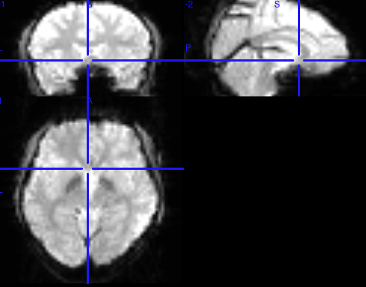
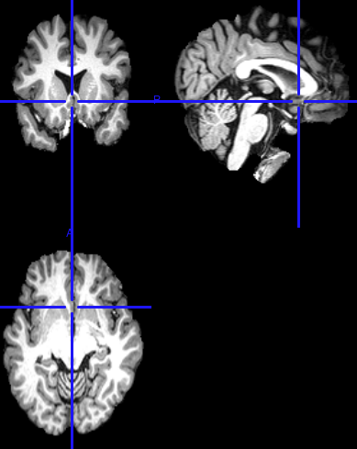
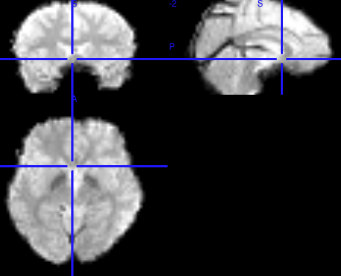
Bet & Coregistration
T1ImgCoreg/Sub_001
Segment
bet
T1Img/Sub_001
RealignParameter/Sub_001/mean*.nii
Apply
Coregister
T1ImgBet/Sub_001
RealignParameter/Sub_001/Bet_mean*.nii
43

Slide 44
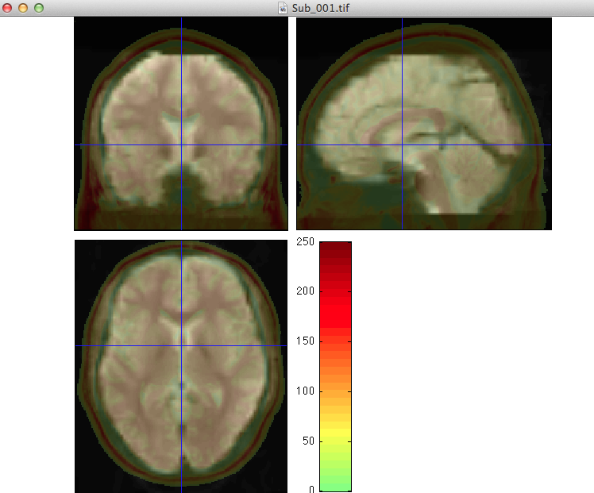
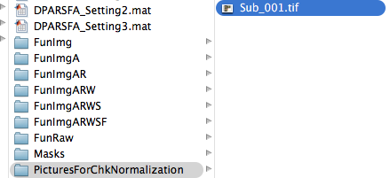
Quality Control
44

Slide 45
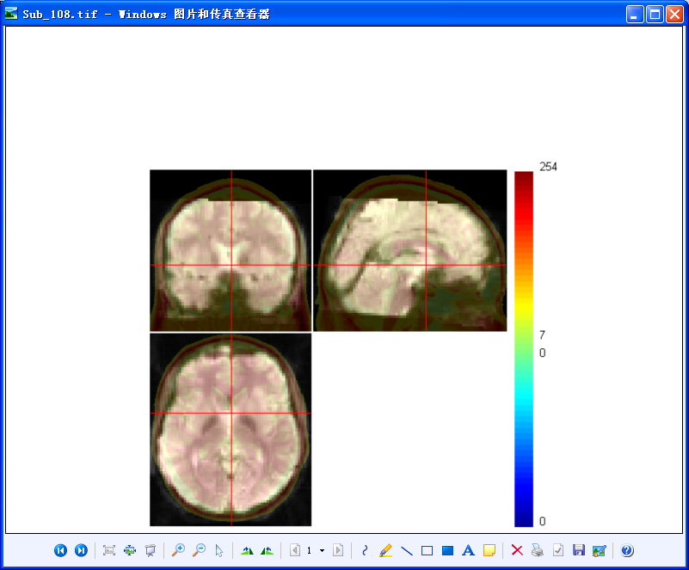
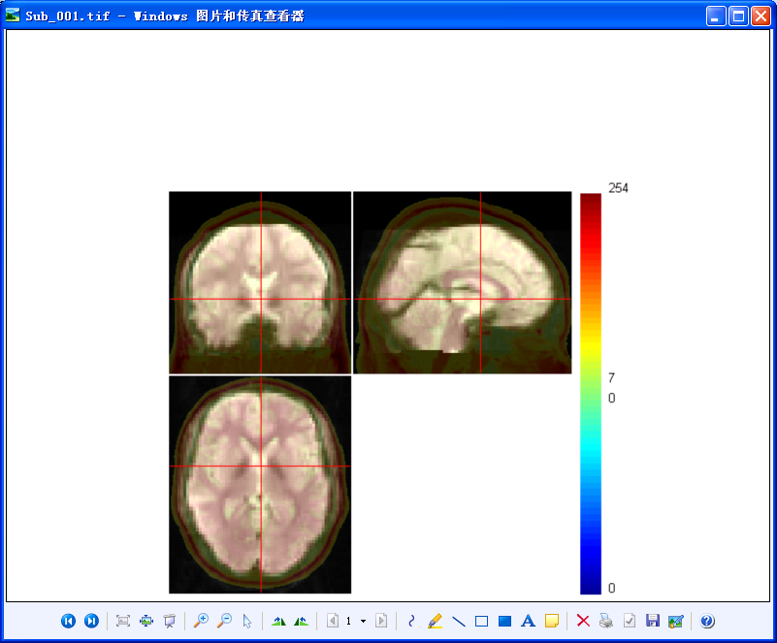
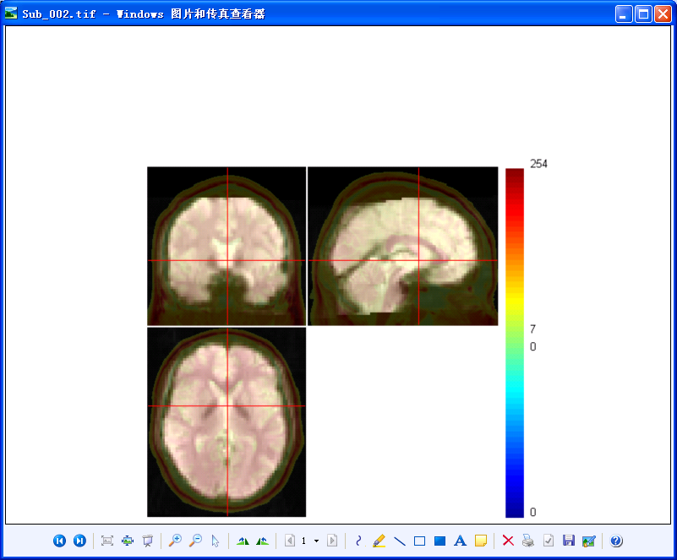
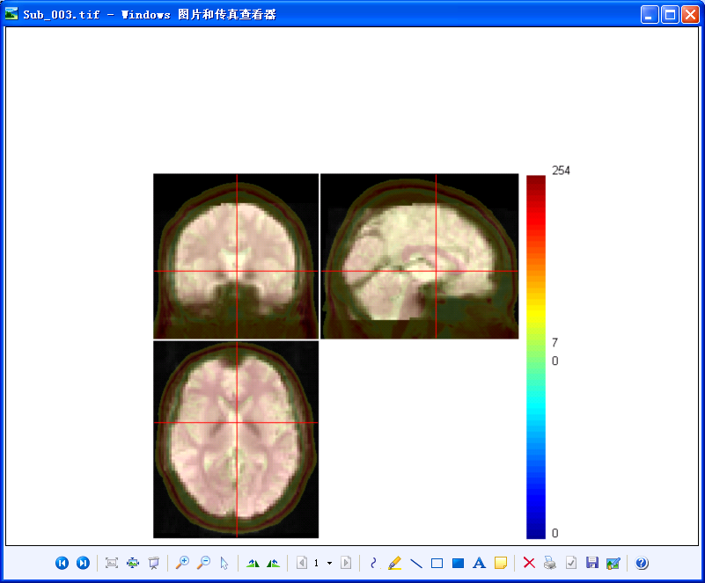
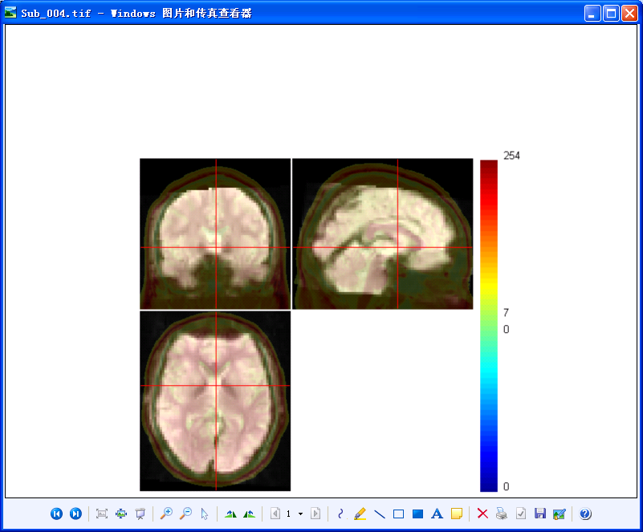
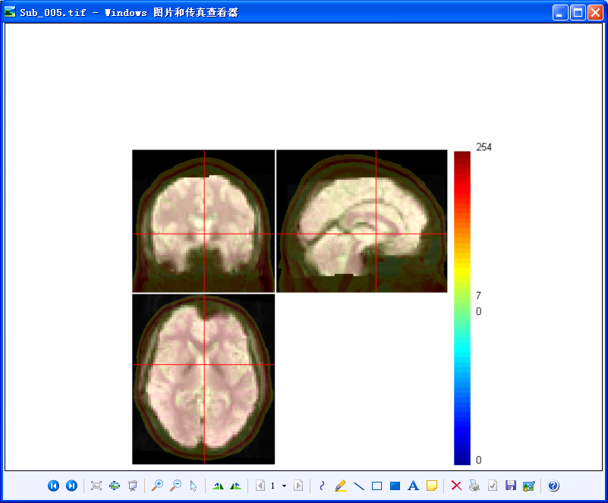
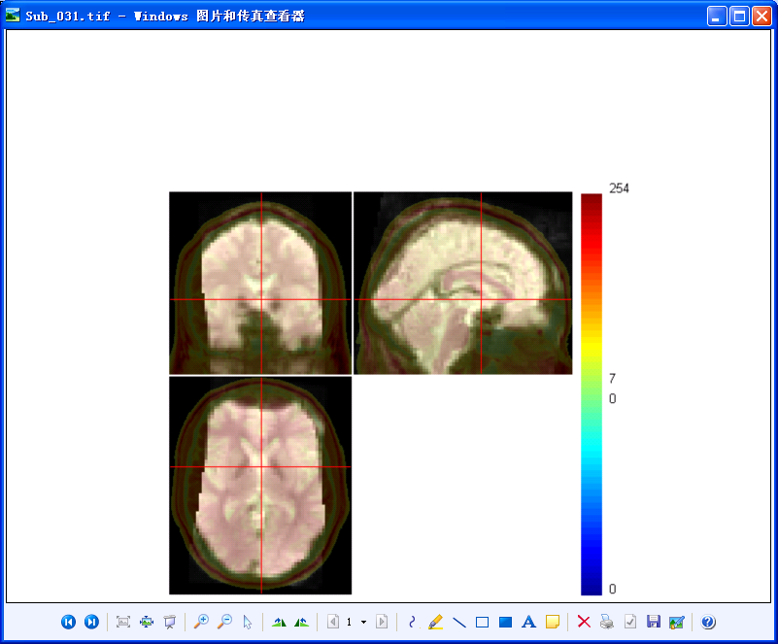
Normalize
Check Normalization with DPARSF
{WORKINGDIR}\PicturesForChkNormalization
45

Slide 46
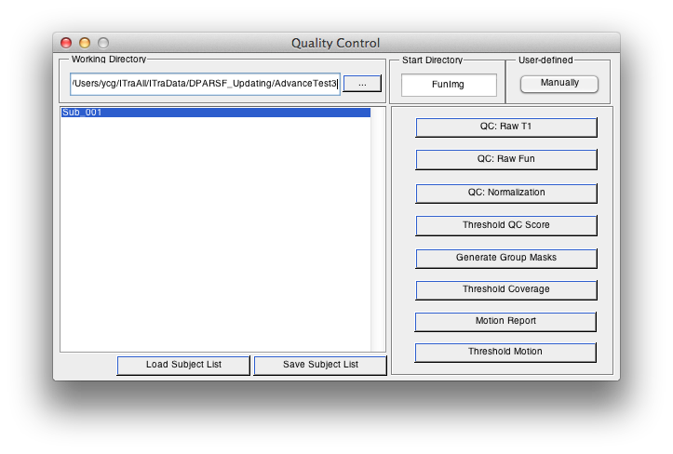
Quality Control
46

Slide 47
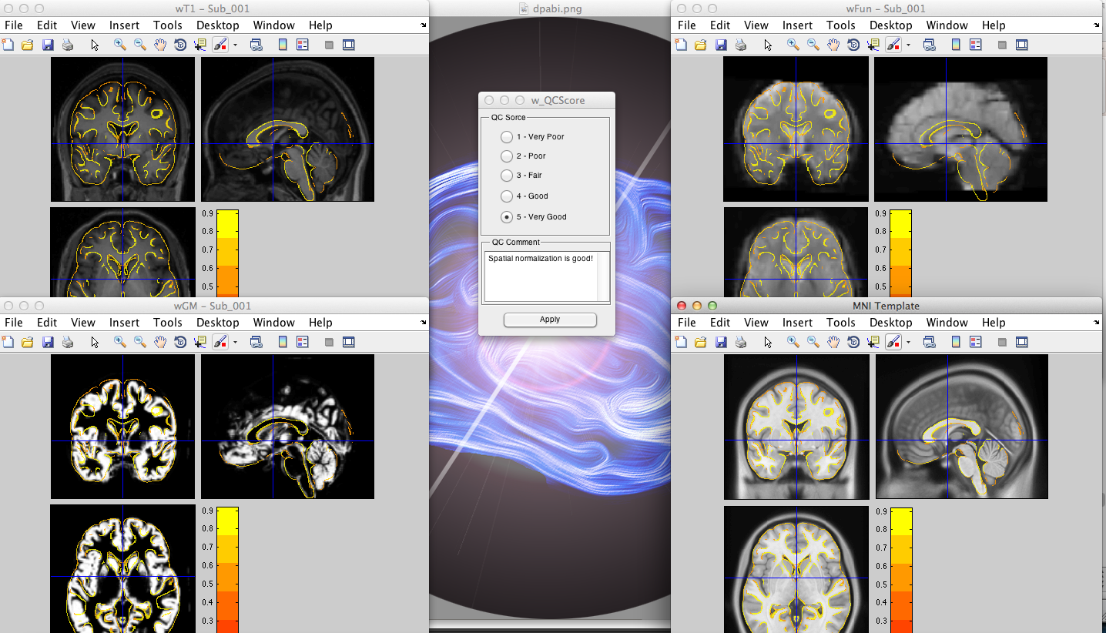
Quality Control
47

Slide 48
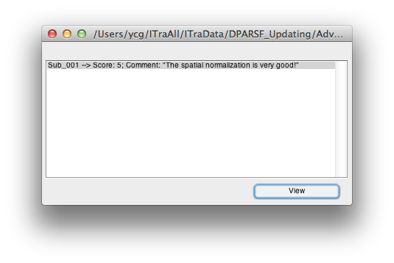
Quality Control
48

Slide 49
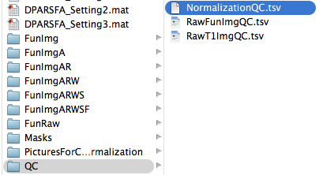
Quality Control
49

Slide 50
DPARSF Basic Edition's procedure
Convert DICOM files to NIFTI images
Remove First 10 Time Points
Slice Timing
Realign
Normalize
Smooth (optional)
Detrend (optional)
Nuisance covariates regression
Calculate ALFF and fALFF
Filter
Calculate ReHo (without smooth in preprocessing)
Calculate Functional Connectivity

Slide 51
Smooth
Why?
Reduce the effects of bad normalization
Increase SNR
…

Slide 52
DPARSF
ReHo: Do not smooth before calculation

Slide 53
DPARSF Basic Edition's procedure
Convert DICOM files to NIFTI images
Remove First 10 Time Points
Slice Timing
Realign
Normalize
Smooth (optional)
Detrend (optional)
Nuisance covariates regression
Calculate ALFF and fALFF
Filter
Calculate ReHo (without smooth in preprocessing)
Calculate Functional Connectivity

Slide 54
DPARSF Basic Edition's procedure
Convert DICOM files to NIFTI images
Remove First 10 Time Points
Slice Timing
Realign
Normalize
Smooth (optional)
Detrend (optional)
Nuisance covariates regression
Calculate ALFF and fALFF
Filter
Calculate ReHo (without smooth in preprocessing)
Calculate Functional Connectivity

Slide 55
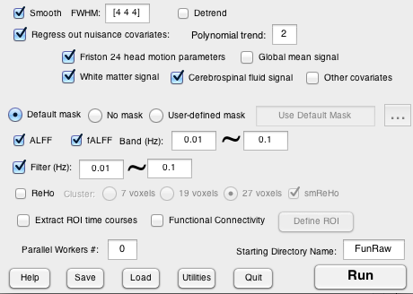
Regress out nuisance Covariates
DPARSF
Polynomial trend
Based on rp*.txt
BrainMask_05_61x73x61.img
WhiteMask_09_61x73x61.img
CsfMask_07_61x73x61.img

Slide 56
DPARSF Basic Edition's procedure
Convert DICOM files to NIFTI images
Remove First 10 Time Points
Slice Timing
Realign
Normalize
Smooth (optional)
Detrend (optional)
Nuisance covariates regression
Calculate ALFF and fALFF
Filter
Calculate ReHo (without smooth in preprocessing)
Calculate Functional Connectivity

Slide 57
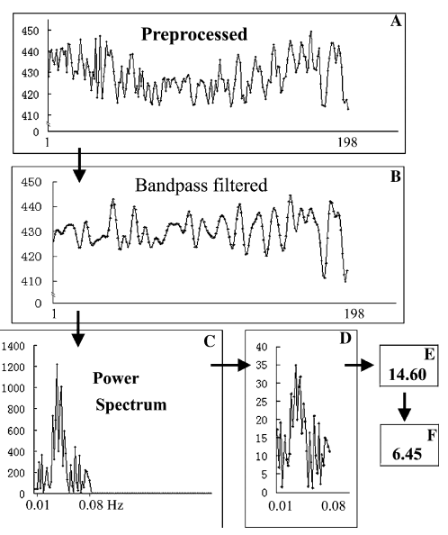
ALFF (Amplitude of Low Frequency Fluctuation )
Zang et al., 2007
Zang YF, He Y, Zhu CZ, Cao QJ, Sui MQ, et al. (2007) Altered baseline brain activity in children with ADHD revealed by resting-state functional MRI. Brain Dev 29: 83–91.

Slide 58
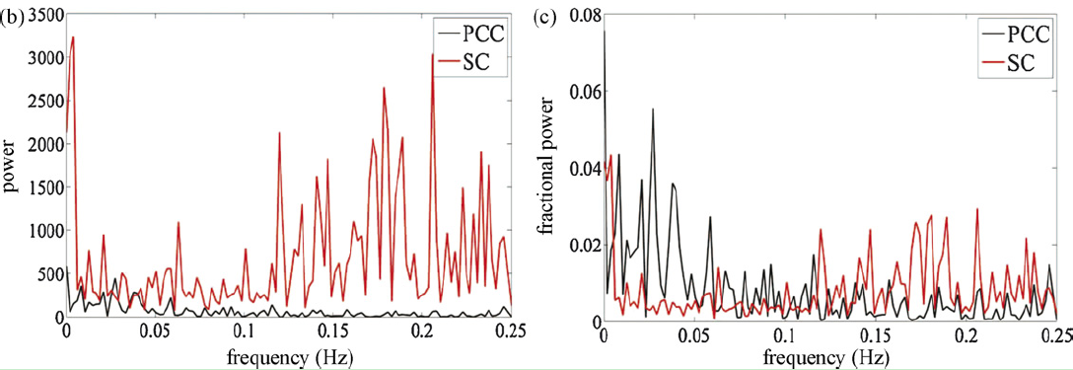
fALFF (fractional ALFF )
PCC: posterior cingulate cortex
SC: suprasellar cistern
Zou et al., 2008
Zou QH, Zhu CZ, Yang Y, Zuo XN, Long XY, et al. (2008) An improved approach to detection of amplitude of low-frequency fluctuation (ALFF) for resting-state fMRI: fractional ALFF. J Neurosci Methods 172: 137-141.

Slide 59
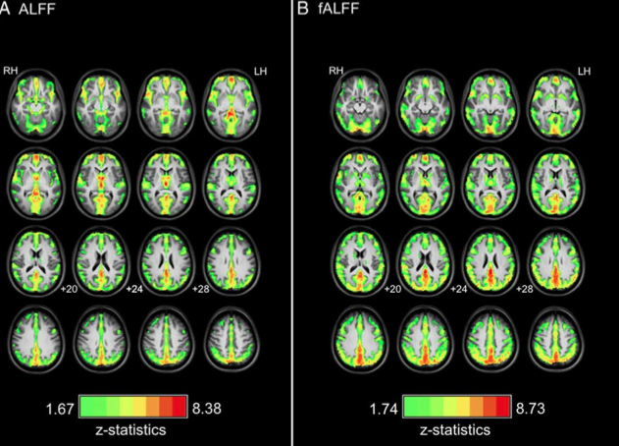
Zuo et al., 2010

Slide 60
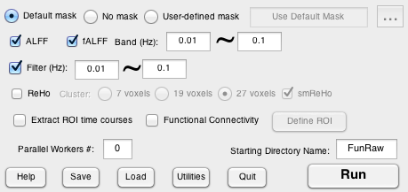
ALFF and fALFF
DPARSF
Please ensure the resolution of your own mask is the same as your functional data.

Slide 61
DPARSF Basic Edition's procedure
Convert DICOM files to NIFTI images
Remove First 10 Time Points
Slice Timing
Realign
Normalize
Smooth (optional)
Detrend (optional)
Nuisance covariates regression
Calculate ALFF and fALFF
Filter
Calculate ReHo (without smooth in preprocessing)
Calculate Functional Connectivity

Slide 62
Filter
Why?
Low frequency (0.01–0.08 Hz) fluctuations (LFFs) of the resting-state fMRI signal were of physiological importance. (Biswal et al., 2005)
LFFs of resting-state fMRI signal were suggested to reflect spontaneous neuronal activity (Logothetis et al., 2001; Lu et al., 2007).
Biswal B, Yetkin FZ, Haughton VM, Hyde JS (1995) Functional connectivity in the motor cortex of resting human brain using echo-planar MRI. Magn Reson Med 34: 537–541.
Logothetis NK, Pauls J, Augath M, Trinath T, Oeltermann A (2001) Neurophysiological investigation of the basis of the fMRI signal. Nature 412: 150–157.
Lu H, Zuo Y, Gu H, Waltz JA, Zhan W, et al. (2007) Synchronized delta oscillations correlate with the resting-state functional MRI signal. Proc Natl Acad Sci U S A 104: 18265–18269.

Slide 63
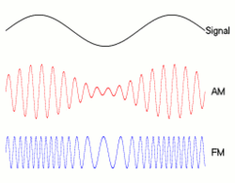
Filter
MoLFF: A theoretical framework of the underlying “mechanisms” for R-fMRI spontaneous fluctuations
Modulation of low frequency fluctuation
HF
LF
http://rfmri.org/MoLFF

Slide 64
DPARSF

Slide 65
DPARSF Basic Edition's procedure
Convert DICOM files to NIFTI images
Remove First 10 Time Points
Slice Timing
Realign
Normalize
Smooth (optional)
Detrend (optional)
Nuisance covariates regression
Calculate ALFF and fALFF
Filter
Calculate ReHo (without smooth in preprocessing)
Calculate Functional Connectivity

Slide 66
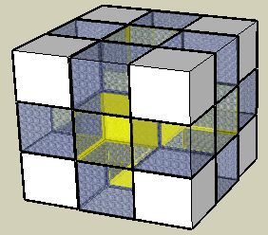
ReHo (Regional Homogeneity)
Note: Please do not smooth your data in preprocessing, just smooth your data after ReHo calculation.
Zang et al., 2004
Zang YF, Jiang TZ, Lu YL, He Y, Tian LX (2004) Regional homogeneity approach to fMRI data analysis. Neuroimage 22: 394–400.

Slide 67
ReHo
DPARSF
Please ensure the resolution of your own mask is the same as your functional data.
Smooth the mReHo results. The FWHM kernel is the same as set in the smooth step.

Slide 68
Outline
Overview
Data Preparation
Preprocess
ReHo, ALFF, fALFF Calculation
Functional Connectivity
Utilities

Slide 69
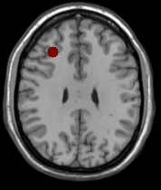
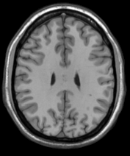
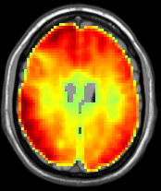
Functional Conncetivity
Voxel-wise
ROI-wise
r=0.36

Slide 70
Functional Connectivity
DPARSF
Please ensure the resolution of your own mask is the same as your functional data.

Slide 71
Functional Connectivity

Slide 72
Functional Connectivity

Slide 73
Functional Connectivity

Slide 74
Functional Connectivity
DPARSF
You will get the Voxel-wise functional connectivity results of each ROI in {working directory}\Results\FC:
zROI1FCMap_Sub_001.img
zROI2FCMap_Sub_001.img
For ROI-wise results, please see Part Utilities: Extract ROI time courses.

Slide 75
Outline
Overview
Data Preparation
Preprocess
ReHo, ALFF, fALFF Calculation
Functional Connectivity
Utilities

Slide 76
Extract ROI Signals
DPARSF

Slide 77
Extract ROI Signals
DPARSF
Results in {working direcotry}\/Results/FunImgARWSCF_ROISignals/:
ROISignals_Sub_001.txt: Time courses, each column represent a time course of one ROI.
ROICorrelation_Sub_001.txt: ROI-wise Functional Connectivity

Slide 78
Save and Load Parameters
DPARSF
Save parameters to *.mat
Load parameters from *.mat

Slide 79
Further Help
Further questions:
http://rfmri.org/dpabi
http://dpabi.org
The R-fMRI Network
79

Slide 80
Further Help
80

Slide 81
81

Slide 82
82

Slide 83
Send emails only to rfmri.org@gmail.com: 1) sending new email means you are posting your personal blogs, 2) replying email means you are posting comments to that topic/blog, 3) then all the other R-fMRI nodes will receive email updates of your posts.
83

Slide 84
The Next BIG Effort Here!
84

Slide 85
“Journal” of the R-fMRI Network (JRN): a free-submission, open-access, “peer viewed” “Journal”
85

Slide 86
http://rfmri.org/HelpUs
86

Slide 87
87

Slide 88
Xin-Di Wang Programmer
Yu-Feng Zang Consultant

Slide 89
Acknowledgments
Nathan Kline Institute
Charles Schroeder
Stan Colcombe
Gary Linn
Mark Klinger
Hangzhou Normal University Yu-Feng Zang
Beijing Normal University
Yong He
NYU Child Study Center
F. Xavier Castellanos
Adriana Di Martino
Clare Kelly
Fudan University
Tian-Ming Qiu
Chinese Academy of Sciences Xi-Nian Zuo
Child Mind Institute
Michael P. Milham
R. Cameron Craddock
Zhen Yang
Princeton University
Han Liu
Notes:
Different Axis!!!

Slide 90
90

